Slide 1






























DIP- Unit-III Image Restoration

Slide 2
Introduction:
As in image enhancement the goal of restoration is to improve an image for further processing.
In contrast to image enhancement that was subjective and largely based on heuristics, restoration attempts to reconstruct or recover an image that has been distorted by a known degradation phenomenon.
Restoration techniques thus try to model the degradation process and apply the inverse process in order to reconstruct the original image.
Restoration attempts to reconstruct or recover an image that has been degraded by using a priori knowledge of the degradation phenomenon.

Slide 3
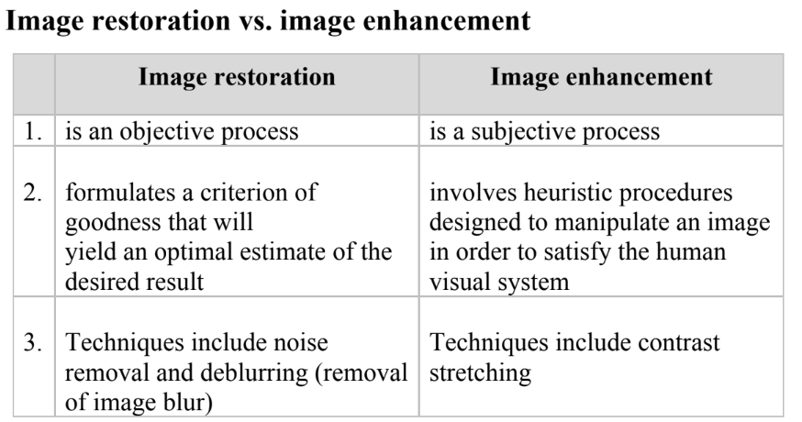

Slide 4
Outline
A Model of the Image Degradation/Restoration Process
Noise Models
Restoration in the Presence of Noise Only-Spatial Filtering
Periodic Noise Reduction by Frequency Domain Filtering
Linear, Position-Invariant Degradations
Estimating the Degradation Function
Inverse Filtering
Minimun Mean Square Error(Wiener) Filtering
Constrained Least Squared Filtering
Geometric Mean Filter
Geometric Transformations

Slide 5
g (x, y) = h(x, y) * F (x, y) + η (x, y)
A Model of the Image Degradation/Restoration Process
If H is a linear, position-invariant process, then the degraded image is given in the spatial domain by
Where h(x,y) is the spatial representation of the degradation function.
Write the model in an equivalent frequency domain representation.
G(u, v) = H (u, v)F (u, v) + N (u, v)

Slide 6
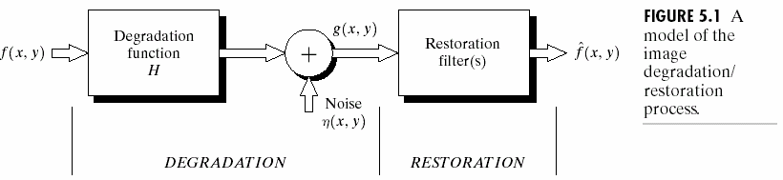
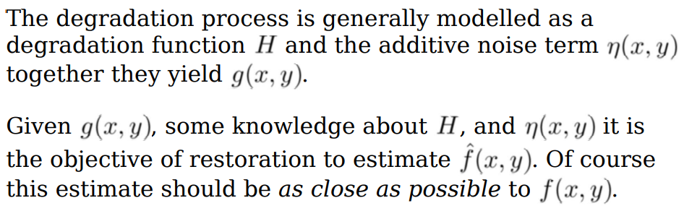
A Model of the Image Degradation/Restoration Process

Slide 7
Noise Models
Spatial and Frequency Properties of Noise
Some Importany Noise Probability Density Functions
Periodic Noise
Estimation of Noise Parameters
Image noise is random variation of brightness or color information in images, and is usually an aspect of electronic noise. It can be produced by the image sensor and circuitry of a scanner or digital camera.

Slide 8
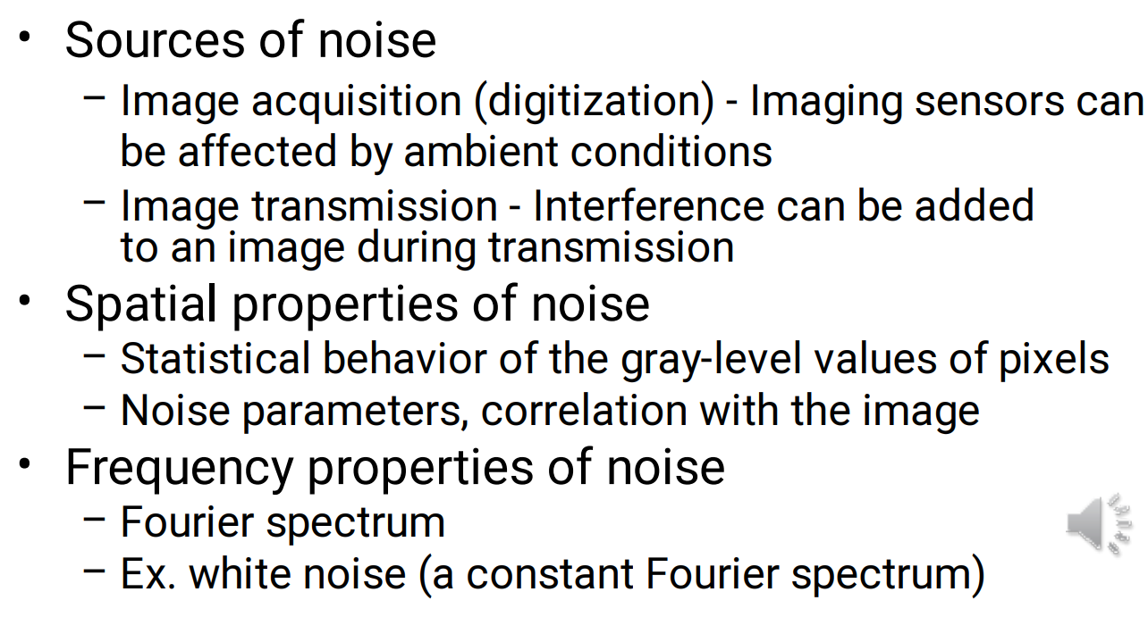
Noise Characteristics

Slide 9
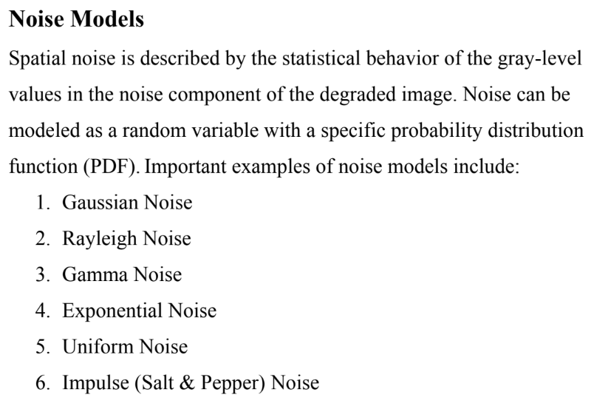

Slide 10
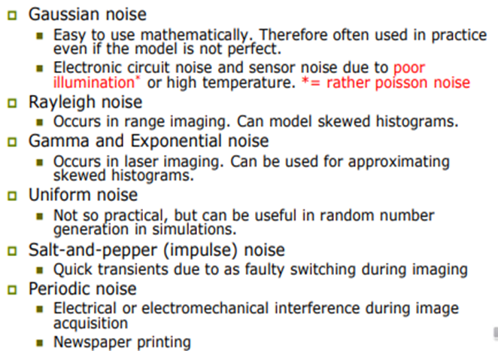

Slide 11
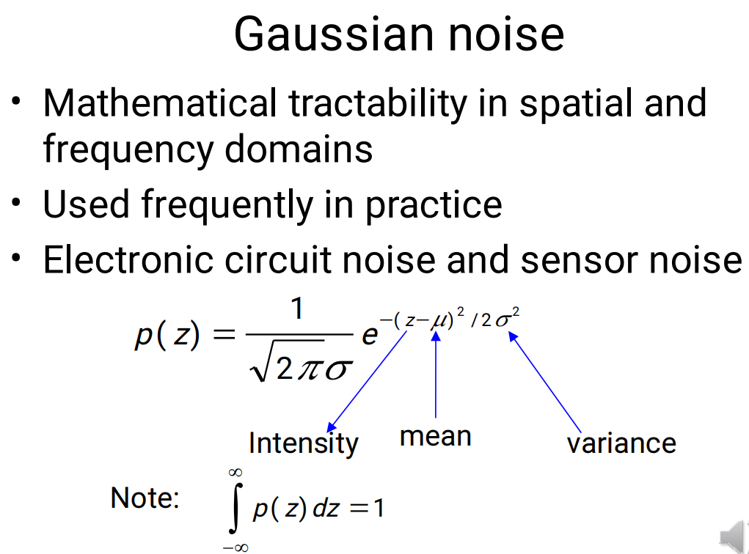
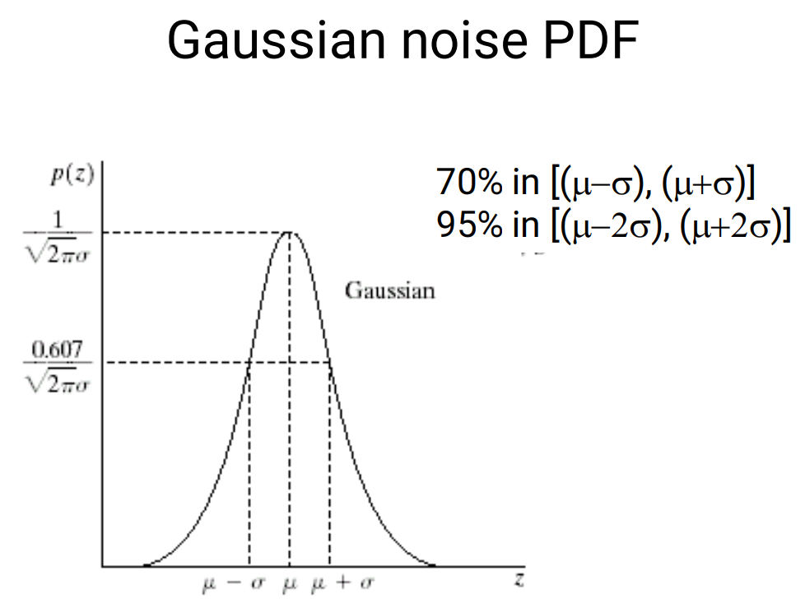
Some Important Noise Probability Density Functions

Slide 12
Rayleigh noise
Some Important Noise Probability Density Functions
The PDF of Rayleigh noise is given by
⎧ 2 _{(z − a)e}−( z−a )² / b
for z ≥ a
for z < a
p(z) = ⎪b
⎨
⎪_{⎩0}
The mean and variance of this density are given by
μ = a + πb / 4
and
_{σ} 2
₌ b(4 − π )
4

Slide 13
Erlang(Gamma) noise
Some Important Noise Probability Density Functions
The PDF of Erlang noise is given by
_{⎧ a}b _{z}b−1
−az
for z ≥ 0
for z < 0
p(z) = ⎪(b − 1)! ^{e}
⎨
⎪₀
⎩
The mean and variance of this density are given by
μ = ^{b}
a
and
_{σ} 2
₌ b
_{a} 2

Slide 14
Exponential noise
Some Important Noise Probability Density Functions
The PDF of exponential noise is given by
_{⎧ae}−az
for z ≥ 0
for z < 0
p(z) = ⎨
⎩0
The mean and variance of this density function are
μ = ¹
a
and
_{σ} 2
₌ 1
_{a} 2

Slide 15
Uniform noise
Some Important Noise Probability Density Functions
The PDF of uniform noise is given by
⎧
1
if a ≤ z ≤ b
otherwise
p(z) = ⎪b − a
⎨
⎪_{⎩0}
The mean of this density function is given by
_{μ =} a + b
2
And its variance by
_{σ 2 =} (b − a)²
12

Slide 16
Impulse (salt-and-pepper) noise
Some Important Noise Probability Density Functions
The PDF of (bipolar) impulse noise is given by
z = a
⎧P_{a}
for
for z = b
p(z) = ⎪P
⎨
⎪₀
b
⎩
otherwise

Slide 17
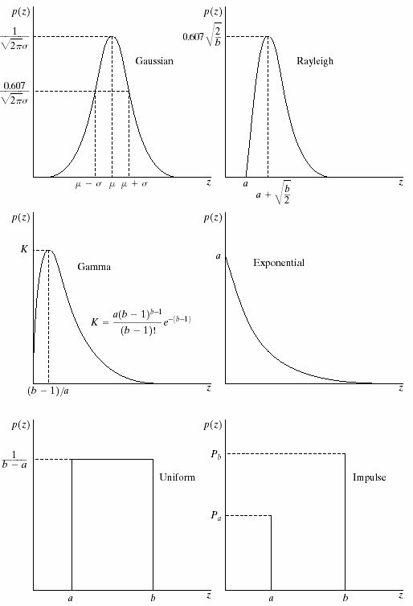
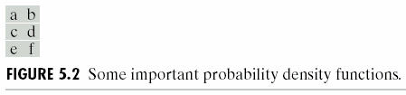
Some Important Noise Probability Density Functions

Slide 18
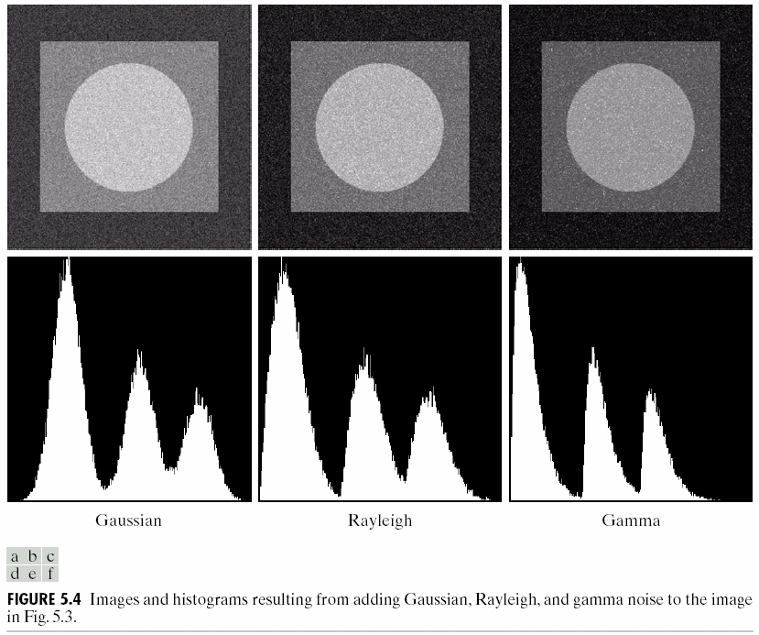
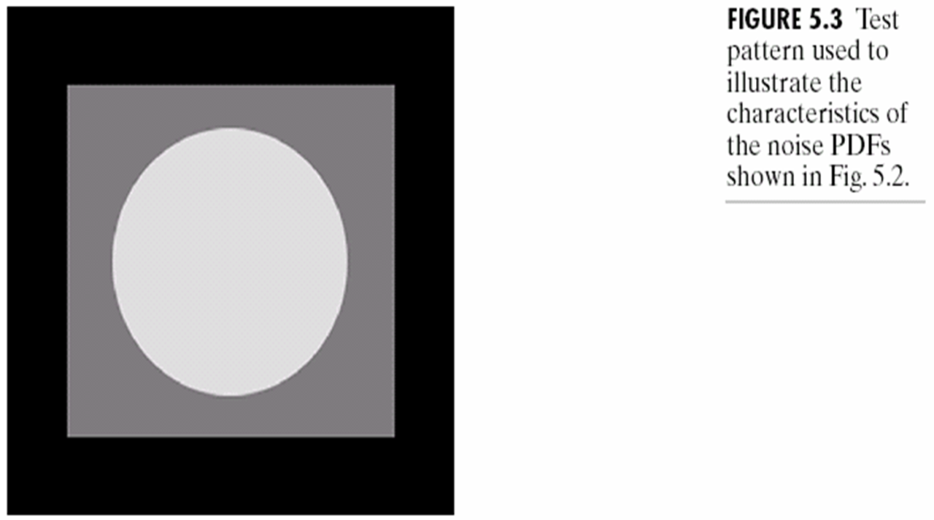
Some Important Noise Probability Density Functions

Slide 19
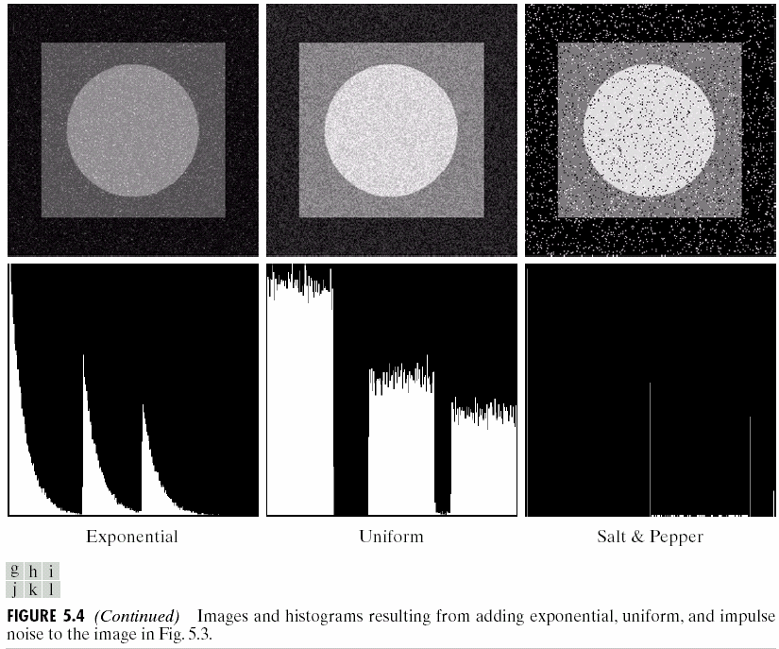

Slide 20
Spatial and Frequency Properties of Noise
Some Importany Noise Probability Density Functions
Periodic Noise
Estimation of Noise Parameters

Slide 21
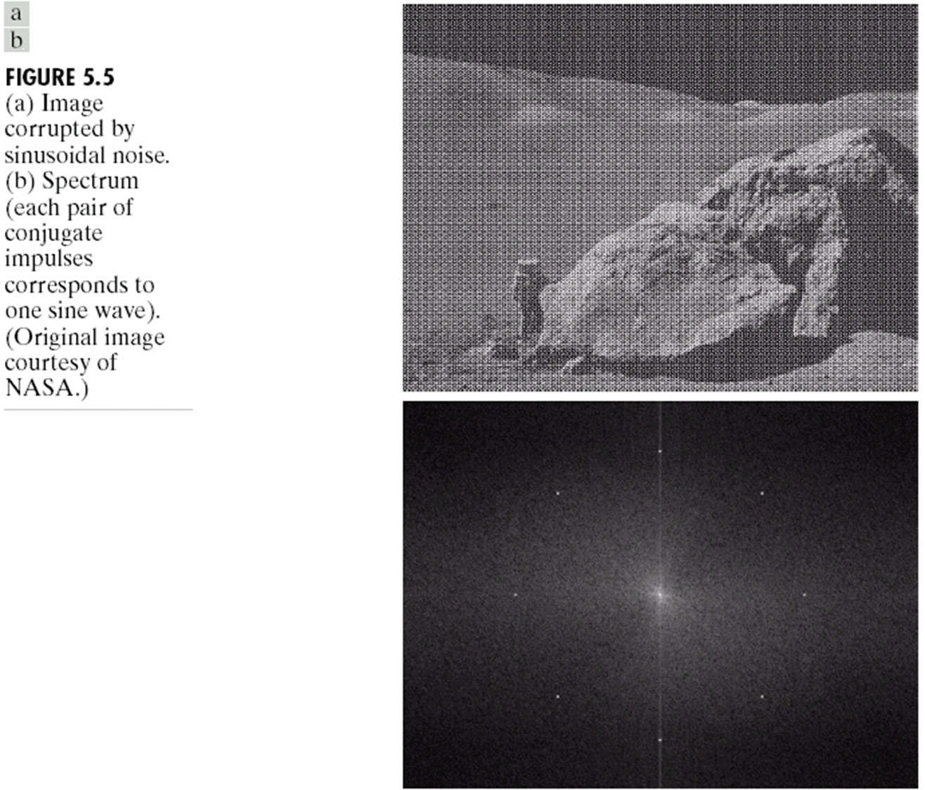
Periodic Noise
Periodic noise in an image irises typically from electrical or electromechanical interference during image acquisition.
Periodic noise can be reduced significantly via frequency domain filtering.

Slide 22
Estimation of Noise Parameters
The parameters of periodic noise typically are estimated by inspection of the Fourier spectrum of the image.
The simplest way to use the data from the image strips is for calculating the mean and variance of the gray levels.

Slide 23
Estimation of Noise Parameters
Consider a strip (subimage) denoted by S. We can use the following sample approximations from basic statistics:
μ = ∑ z_{i} p(z_{i} )
z_{i}∈S
and
σ ² = ∑(z
− u)² p(z )
i i
z_{i}∈S
where the zi’s are the gray-level values of the pixels in S, and p(z_{i}) are the corresponding normalized histogram values.

Slide 24
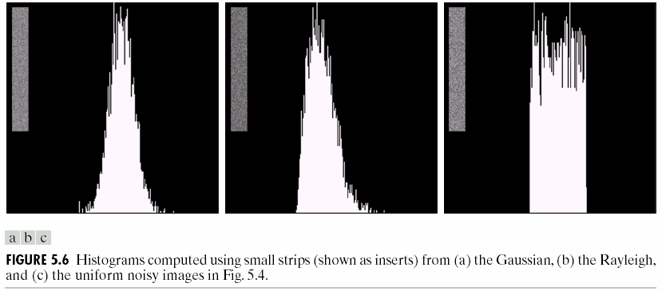
Estimation of Noise Parameters

Slide 25
Outline
A Model of the Image Degradation/Restoration Process
Noise Models
Restoration in the Presence of Noise Only-Spatial Filtering
Periodic Noise Reduction by Frequency Domain Filtering
Linear, Position-Invariant Degradations
Estimating the Degradation Function
Inverse Filtering
Minimun Mean Square Error(Wiener) Filtering
Constrained Least Squared Filtering
Geometric Mean Filter
Geometric Transformations

Slide 26
g (x, y) = f (x, y) + η (x, y)
Restoration in the Presence of Noise Only-Spatial Filtering-Methods
When the only degradation present in an image is noise
and
G(u, v) = F (u, v) + N (u, v)
Mean Filters
Order-Statistics Filters
Adaptive Filters

Slide 27
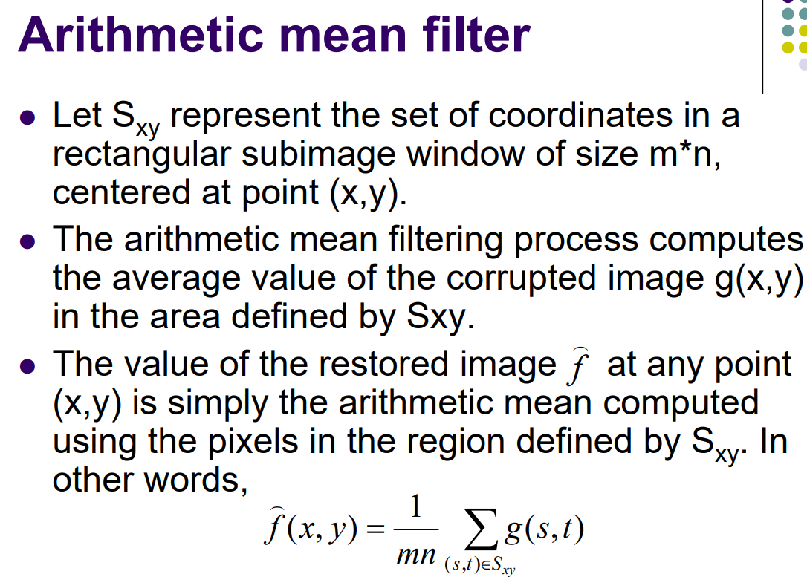
Restoration in the Presence of Noise Only-Spatial Filtering- Mean Filter

Slide 28
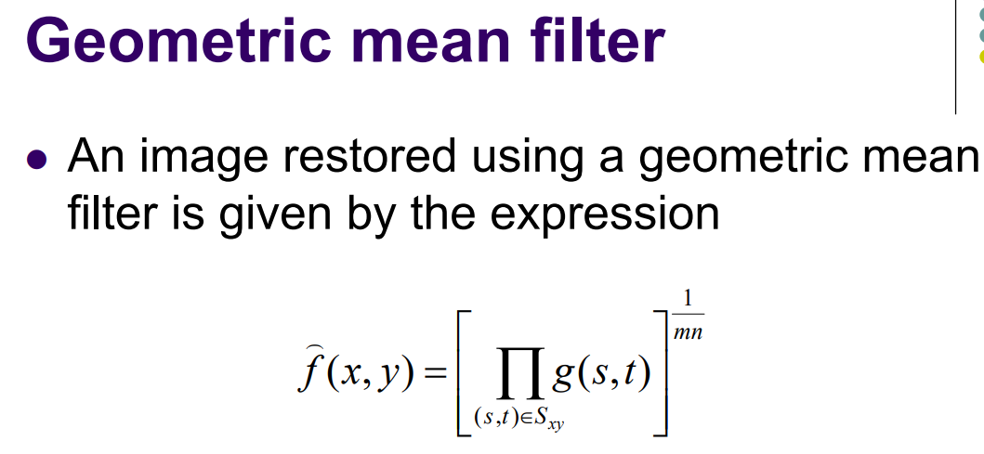
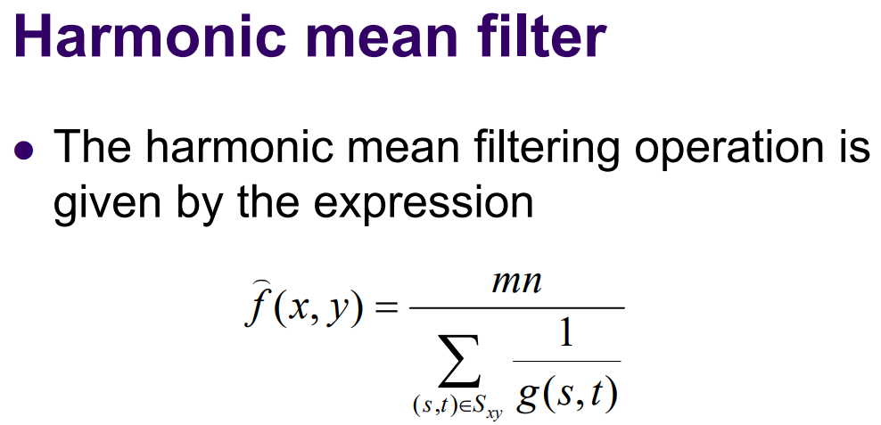
Restoration in the Presence of Noise Only-Spatial Filtering-Mean filter

Slide 29
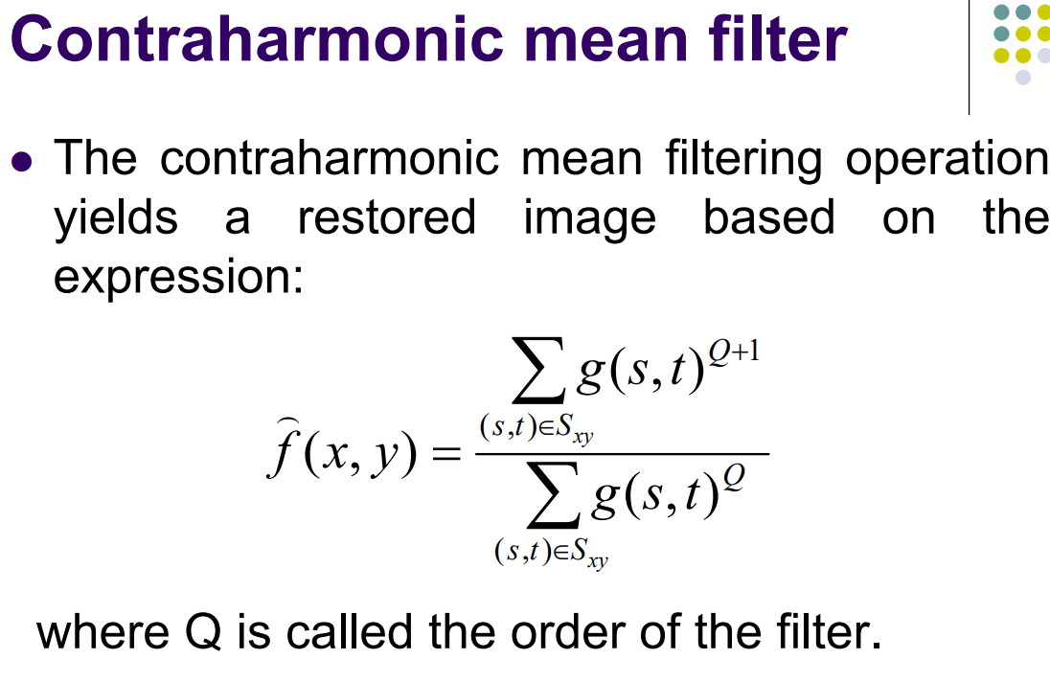
Restoration in the Presence of Noise Only-Spatial Filtering-Mean filter

Slide 30
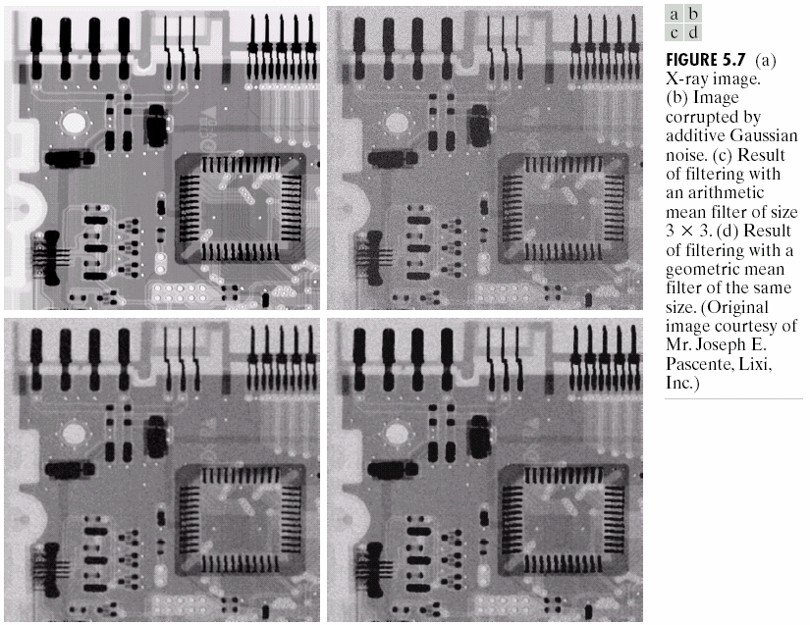

Slide 31
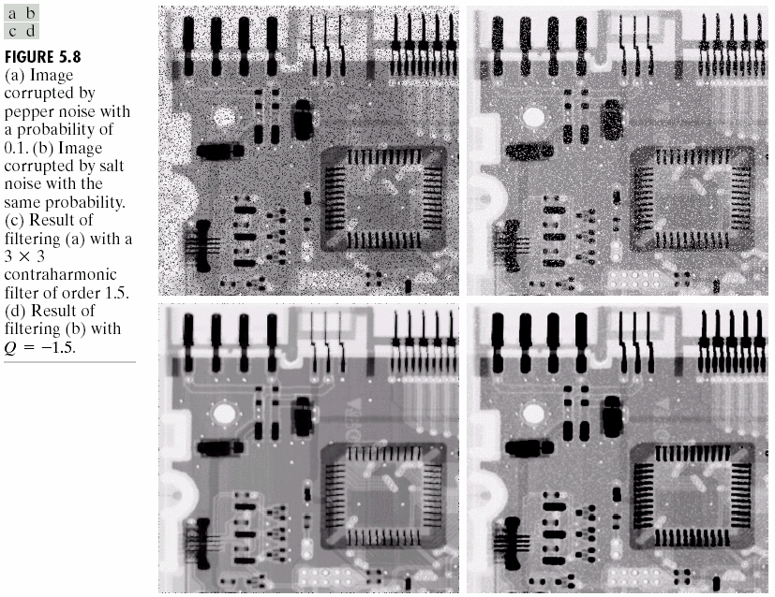

Slide 32
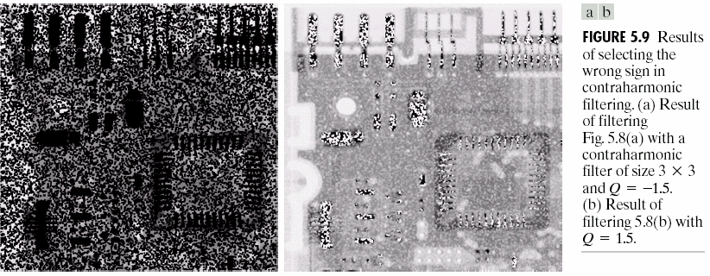

Slide 33
Restoration in the Presence of Noise Only-Spatial Filtering
Mean Filters
Order-Statistics Filters
Adaptive Filters

Slide 34
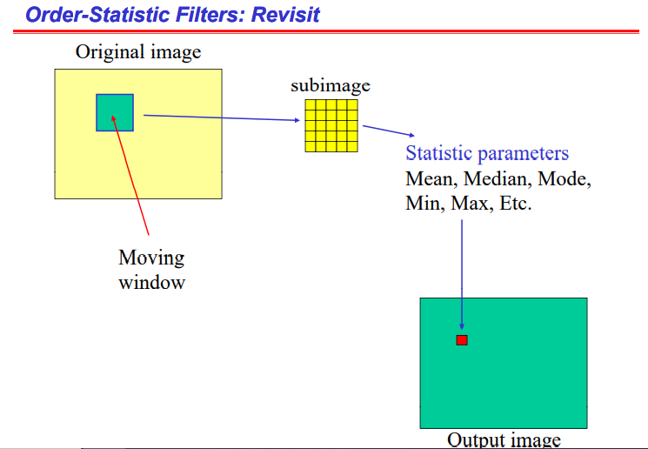

Slide 35
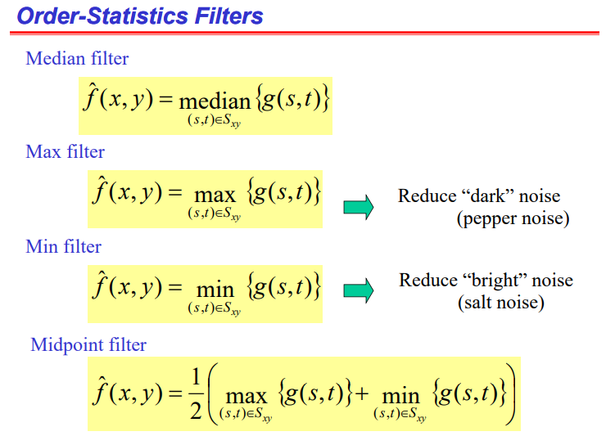
Reduce Impulse noise
Reduce Gaussian , uniform noise

Slide 36
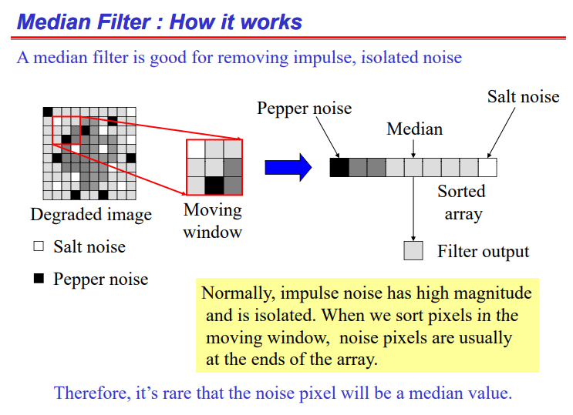

Slide 37
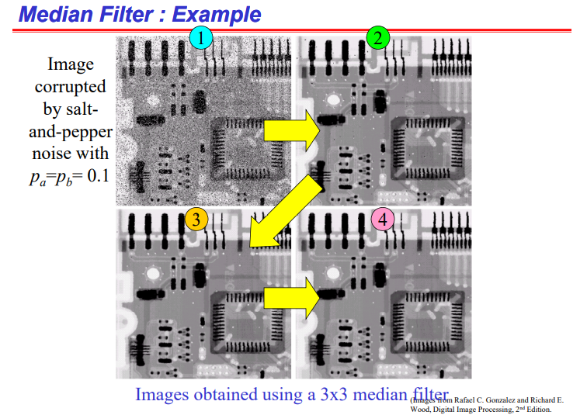

Slide 38
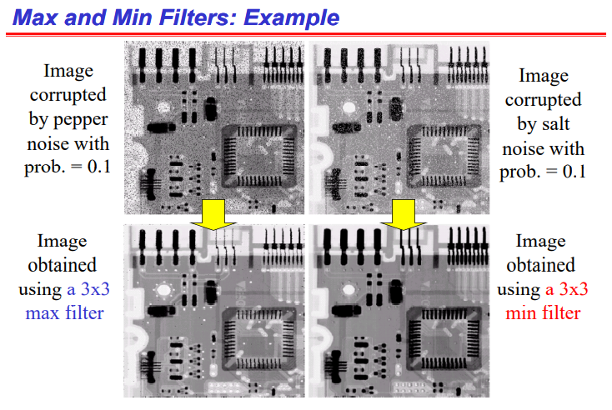

Slide 39
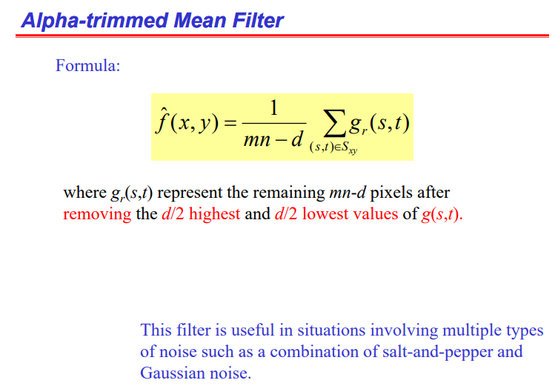
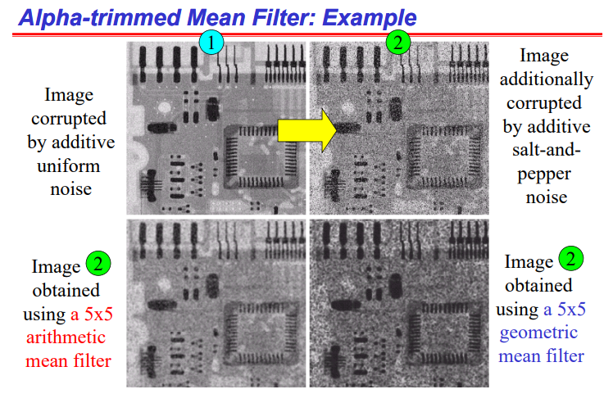
If d=0: act as Arithmetic mean filter
If d= mn-1: acts as Median filter
Reduce Gaussian , Salt and Pepper noise

Slide 40
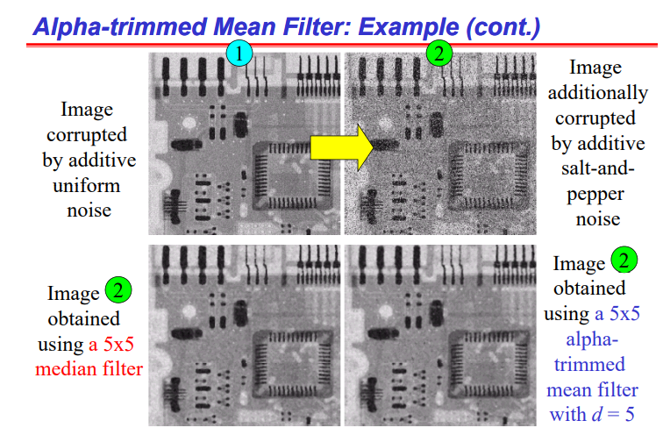
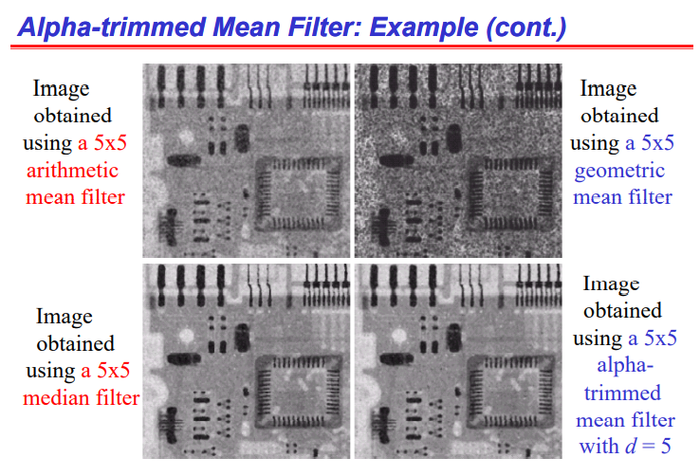

Slide 41
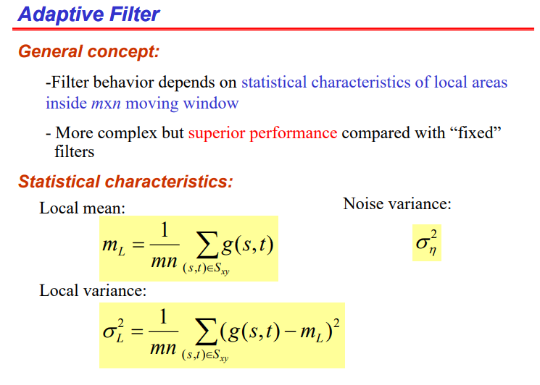
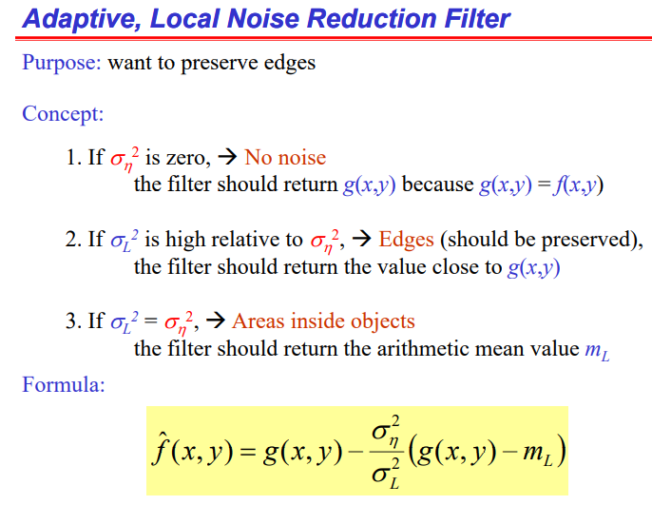
Adaptive filters, in contrast, have coeficients that are allowed to vary over time
Types of Adaptive filters:
Adaptive, Local Noise Reduction filter
Adaptive median filter

Slide 42
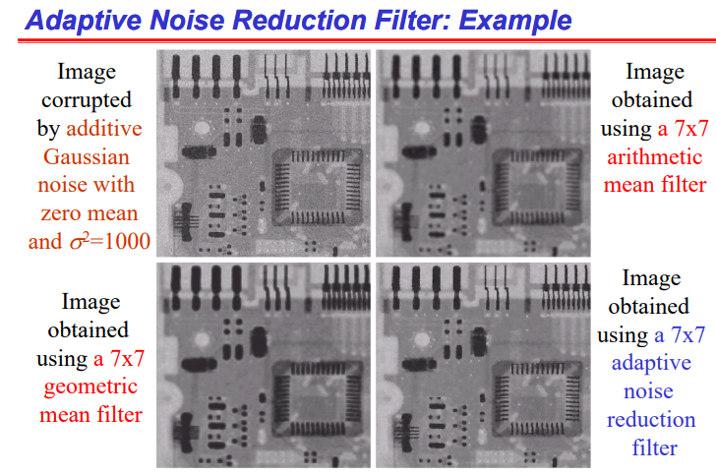
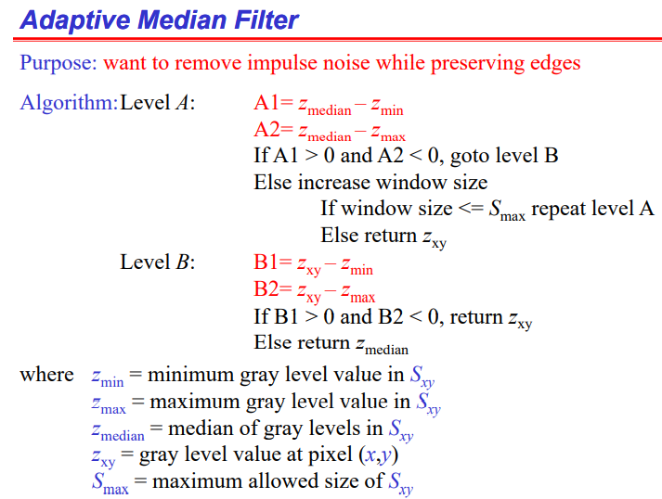
An adaptive median filter discriminates pixels in the filtering window as corrupted and uncorrupted and then a filtering technique is applied to corrupted pixels in the window. In this method noisy pixels are replaced by the median value of the pixels in the filtering window.

Slide 43
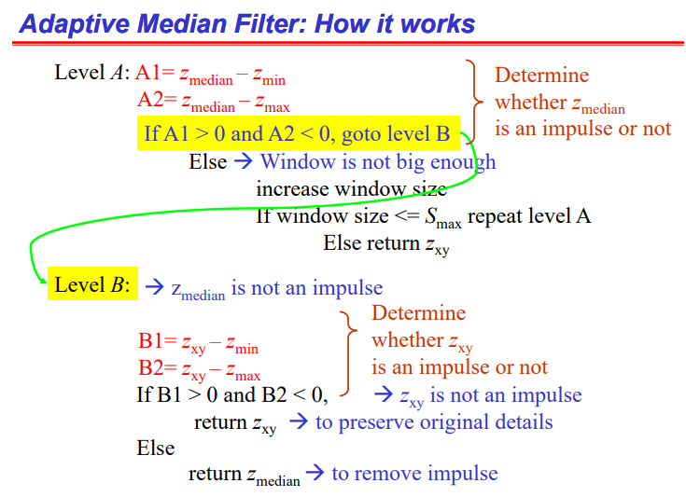
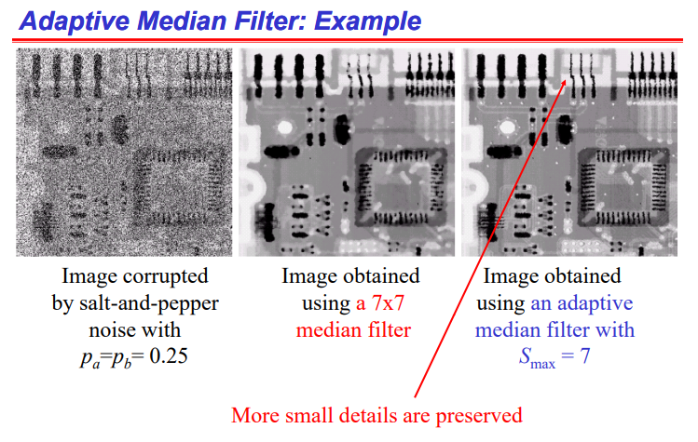

Slide 44
Outline
A Model of the Image Degradation/Restoration Process
Noise Models
Restoration in the Presence of Noise Only-Spatial Filtering
Periodic Noise Reduction by Frequency Domain Filtering
Linear, Position-Invariant Degradations
Estimating the Degradation Function
Inverse Filtering
Minimun Mean Square Error(Wiener) Filtering
Constrained Least Squared Filtering
Geometric Mean Filter
Geometric Transformations

Slide 45
Periodic Noise Reduction by Frequency Domain Filtering
Types of frequency Filters
Bandreject Filters
Bandpass Filters
Notch Filters

Slide 46
Periodic Noise Reduction by Frequency Domain Filtering
Band reject Filter:
Bandreject filters remove or attenuate a band of frequencies about the origin of the Fourier transform.
An ideal bandreject filter is given by the expression
⎧₁
if D(u, v) < D
W
⎪
⎪
0
2
H(u, v) = ⎪
⎨0
if D₀ −
W
≤ D(u, v) ≤ D +
W
⎪
2
0
2
⎪
W
⎪1 if D(u, v) > D₀ + ₂
⎩
Where D(u,v) is the distance from the origin of the centered frequency rectangle, W is the width of the band, and D0 is its radial center.

Slide 47
Periodic Noise Reduction by Frequency Domain Filtering
Butterworth, Gaussian Filter:
A Butterworth bandreject filter of order n is given by the expression:
1
H(u, v) =
⎤2n
⎡
D(u, v)W
1 +
⎢
⎥
2 2
D (u, v) − D
⎣ 0 ⎦
And a Gaussian bandreject filter is given by
1 ⎡ D² (u,v)−D² ⎤
−
⎢ 0 ⎥
H(u, v) = 1 − e
2 ⎣⎢ D(u,v)W
⎥⎦

Slide 48
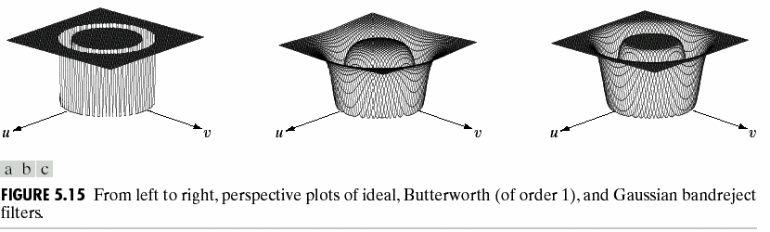
Periodic Noise Reduction by Frequency Domain Filtering

Slide 49
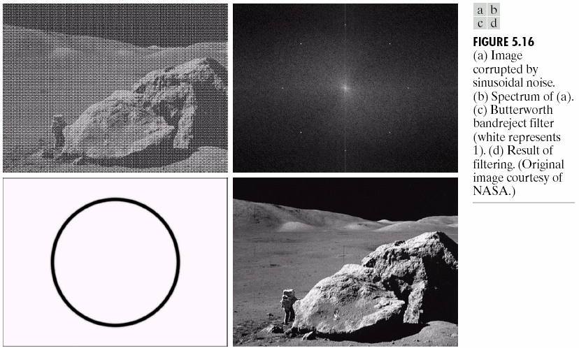
Periodic Noise Reduction by Frequency Domain Filtering

Slide 50
Periodic Noise Reduction by Frequency Domain Filtering
Bandreject Filters
Bandpass Filters
Notch Filters

Slide 51
Periodic Noise Reduction by Frequency Domain Filtering
Bandpass Filter:
The transfer function H_{bp}(u,v) of a bandpass filter obtained from a corresponding bandreject filter with transfer function H_{br}(u,v) by using the equation
H_{bp}(u,v)=1-H_{br}(u,v)

Slide 52
Periodic Noise Reduction by Frequency Domain Filtering
Notch reject Filter:- Ideal filter
The transfer function of an ideal notch reject filter of radius D0, with centers at(u0,v0) and, by symmetry, at(-u0,-v0), is
if D(u, v) ≤ D₀ or D₂ (u, v) ≤ D₀
⎩1 otherwise
H(u, v) = ^{⎧0}
⎨
where
[(u − M / 2 −
v − N / 2 − v ) ]
u ) + (
1/ 2
D (u, v) =
2
2
1
0
0
and
D (u, v) = [(
u ) + (v − N / 2 + v ) ]
u − M / 2 +
2
2
1/ 2
2
0
0

Slide 53
Periodic Noise Reduction by Frequency Domain Filtering
Notch Filter-Butterworth, Gaussian notch Filter:
The transfer function of a Butterworth notch reject filter of order n is given by
1
H(u, v) =
⎤n
⎡
_{D}2
_{1 + ⎢} 0 ⎥
⎣D₁ (u, v)D₂ (u, v) ⎦
A Gaussian notch reject filter has the form
⎡ ⎤
1 D (u,v)D (u,v)
−
₂ ⎢
1
_{D}2
2
⎥
H(u, v) = 1 − e
⎢⎣
0
⎥⎦

Slide 54
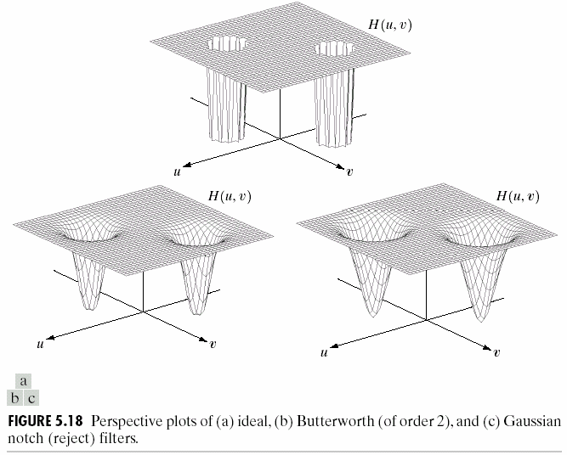
Periodic Noise Reduction by Frequency Domain Filtering

Slide 55
Outline
A Model of the Image Degradation/Restoration Process
Noise Models
Restoration in the Presence of Noise Only-Spatial Filtering
Periodic Noise Reduction by Frequency Domain Filtering
Linear, Position-Invariant Degradations
Estimating the Degradation Function
Inverse Filtering
Minimun Mean Square Error(Wiener) Filtering
Constrained Least Squared Filtering
Geometric Mean Filter
Geometric Transformations

Slide 56
g(x, y) = H [ f (x, y)]+η(x, y)
Linear, Position-Invariant Degradations
The input-output relationship is expressed as
η (x, y) = 0
H is linear if
H [af₁ (x, y) + bf₂ (x, y)] = aH [ f₁ (x, y)]+ bH [ f ₂ (x, y)]

Slide 57
Linear, Position-Invariant Degradations
An operator having the
input-output is said to be
relationship
g(x, y) = H [ f (x, y)]
position invariant if
H [ f (x − a, y − b)] = g(x − a, y − b)
f (x, y) = _{∫−∞ ∫−∞} f (α , β )δ (x − α , y − β )dαdβ
∞ ∞

Slide 58
g(x, y) = _{∫−∞ ∫−∞} f (α , β )h(x,α , y, β )dαdβ
Linear, Position-Invariant Degradations
∞ ∞
h(x,α , y, β ) = H [δ (x − α , y − β )]
Where
If H is position invariant
H [δ (x − α , y − β )] = h(x − α , y − β )
then,
g(x, y) = _{∫−∞ ∫−∞} f (α , β )h(x − α , y − β )dαdβ
This expression is called the convolution integral.
∞ ∞

Slide 59
Outline
A Model of the Image Degradation/Restoration Process
Noise Models
Restoration in the Presence of Noise Only-Spatial Filtering
Periodic Noise Reduction by Frequency Domain Filtering
Linear, Position-Invariant Degradations
Estimating the Degradation Function
Inverse Filtering
Minimun Mean Square Error(Wiener) Filtering
Constrained Least Squared Filtering
Geometric Mean Filter
Geometric Transformations

Slide 60
Estimating the Degradation Function
Estimation by Image Observation
Estimation by Experimentation
Estimation by Modeling

Slide 61
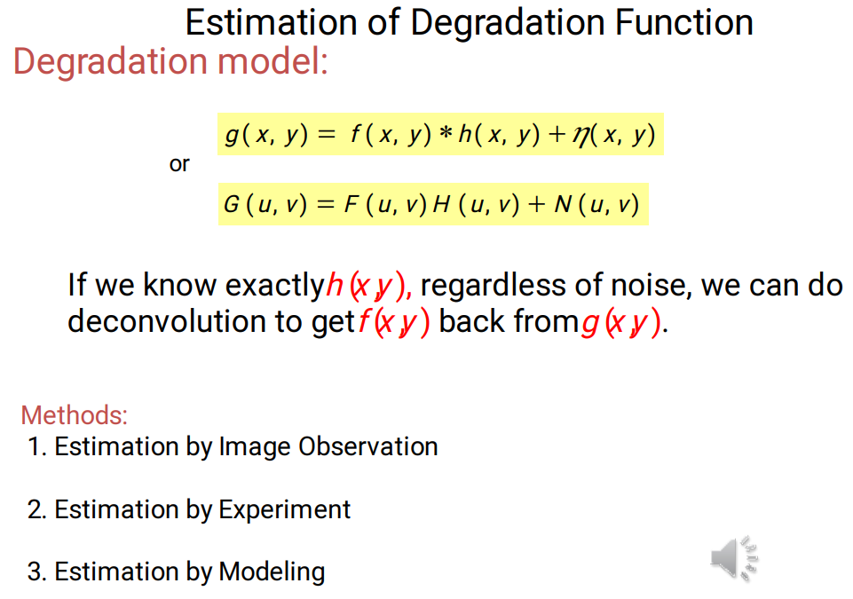
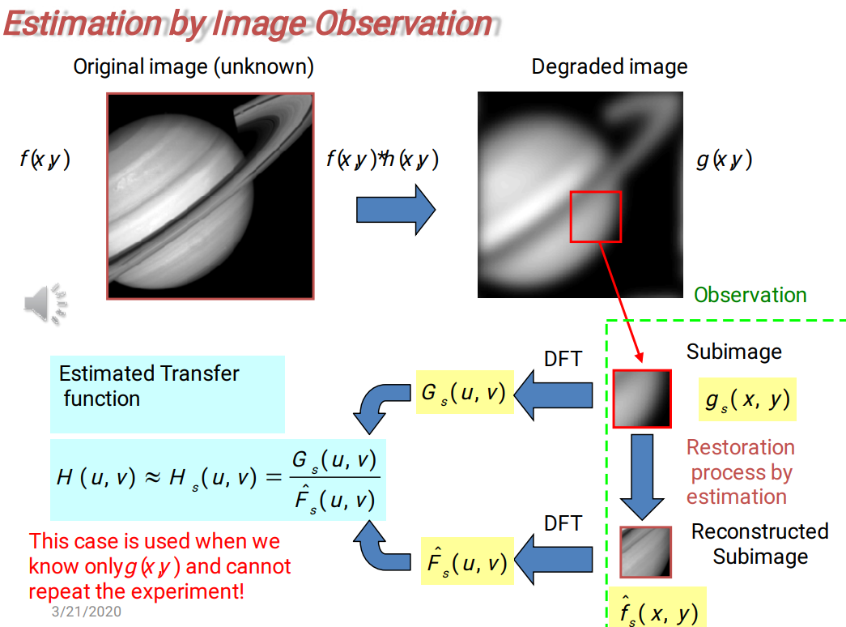

Slide 62
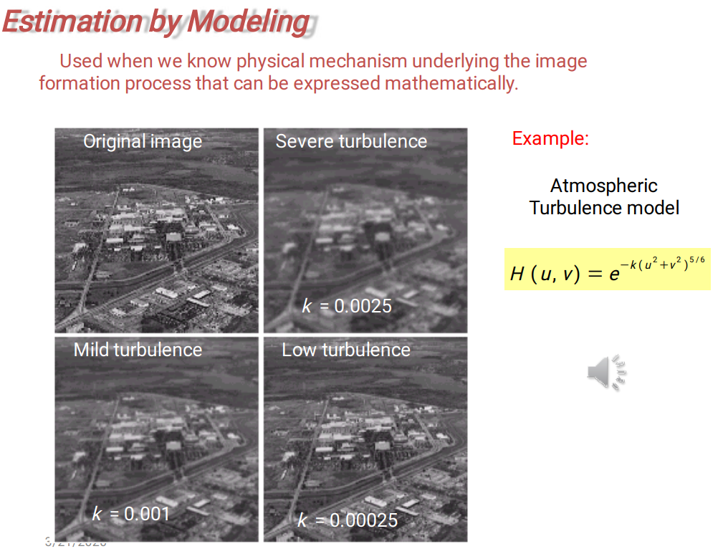
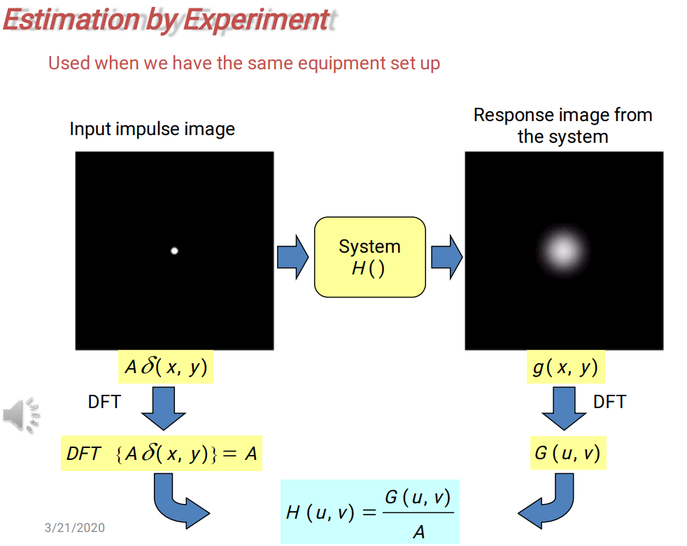

Slide 63
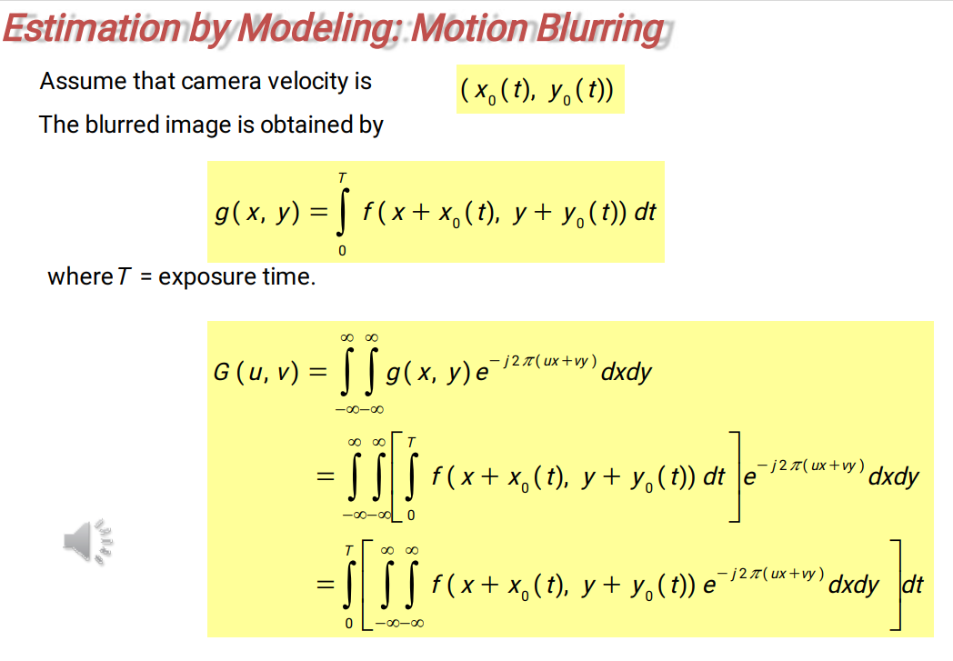

Slide 64
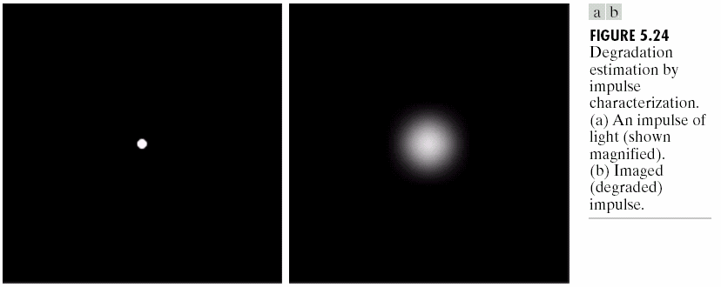
Estimating the Degradation Function

Slide 65
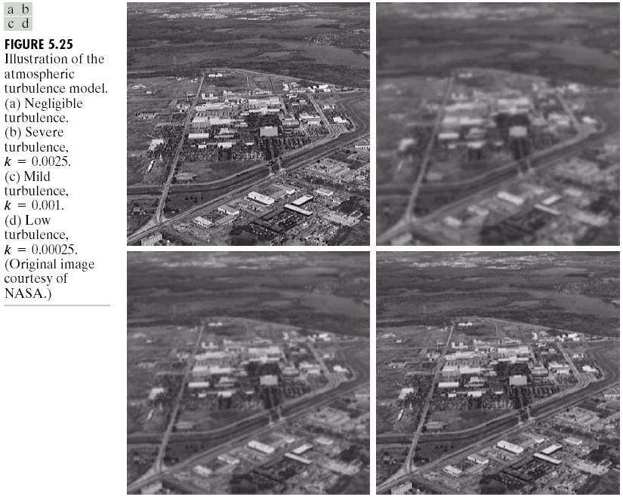
Estimating the Degradation Function

Slide 66
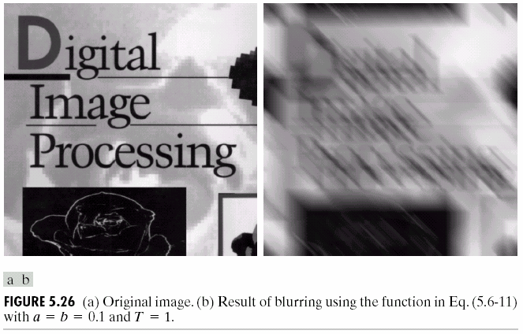
Estimating the Degradation Function

Slide 67
Outline
A Model of the Image Degradation/Restoration Process
Noise Models
Restoration in the Presence of Noise Only-Spatial Filtering
Periodic Noise Reduction by Frequency Domain Filtering
Linear, Position-Invariant Degradations
Estimating the Degradation Function
Inverse Filtering
Minimun Mean Square Error(Wiener) Filtering
Constrained Least Squared Filtering
Geometric Mean Filter
Geometric Transformations

Slide 68
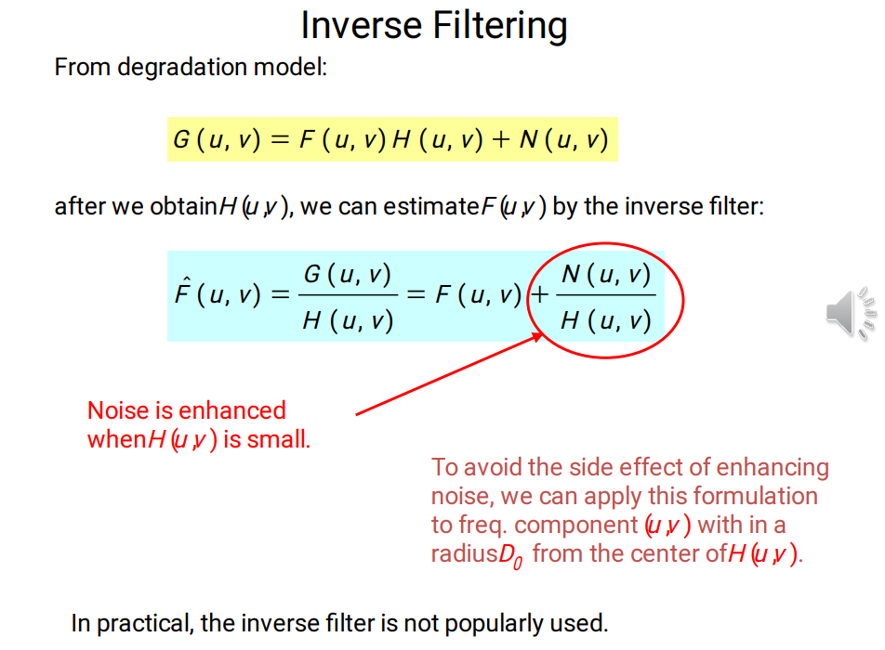

Slide 69
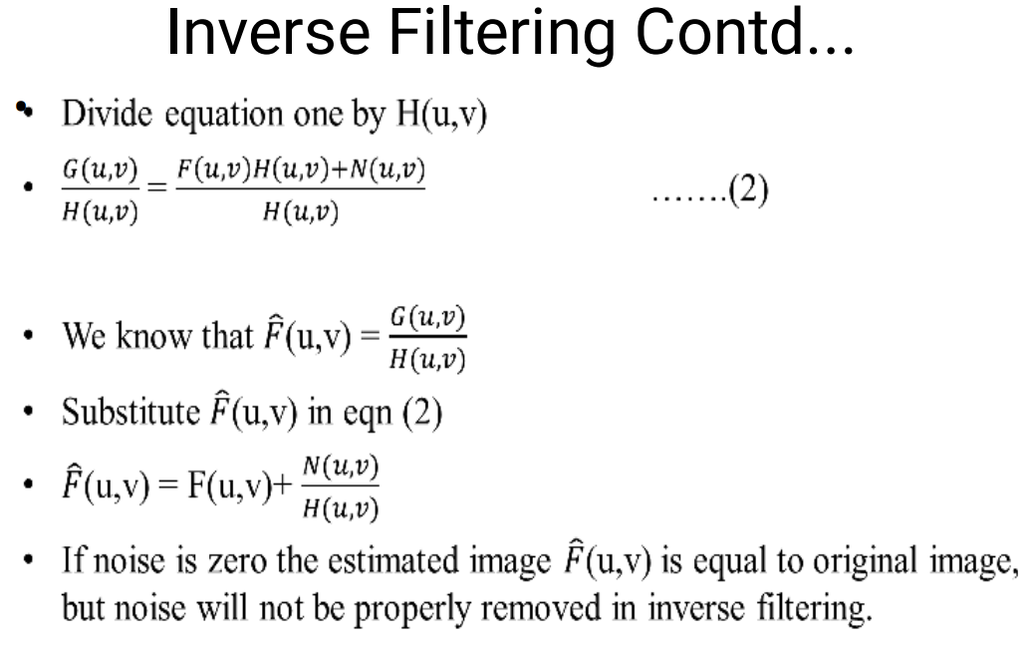


Slide 70

Inverse Filtering

Slide 71
Outline
A Model of the Image Degradation/Restoration Process
Noise Models
Restoration in the Presence of Noise Only-Spatial Filtering
Periodic Noise Reduction by Frequency Domain Filtering
Linear, Position-Invariant Degradations
Estimating the Degradation Function
Inverse Filtering
Minimun Mean Square Error(Wiener) Filtering
Constrained Least Squared Filtering
Geometric Mean Filter
Geometric Transformations

Slide 72



Slide 73



Slide 74


Slide 75
Outline
A Model of the Image Degradation/Restoration Process
Noise Models
Restoration in the Presence of Noise Only-Spatial Filtering
Periodic Noise Reduction by Frequency Domain Filtering
Linear, Position-Invariant Degradations
Estimating the Degradation Function
Inverse Filtering
Minimun Mean Square Error(Wiener) Filtering
Constrained Least Squared Filtering
Geometric Mean Filter
Geometric Transformations

Slide 76



Slide 77



Slide 78



Slide 79
Outline
A Model of the Image Degradation/Restoration Process
Noise Models
Restoration in the Presence of Noise Only-Spatial Filtering
Periodic Noise Reduction by Frequency Domain Filtering
Linear, Position-Invariant Degradations
Estimating the Degradation Function
Inverse Filtering
Minimun Mean Square Error(Wiener) Filtering
Constrained Least Squared Filtering
Geometric Mean Filter
Geometric Transformations

Slide 80



Slide 81



Slide 82



Slide 83



